Slide 1

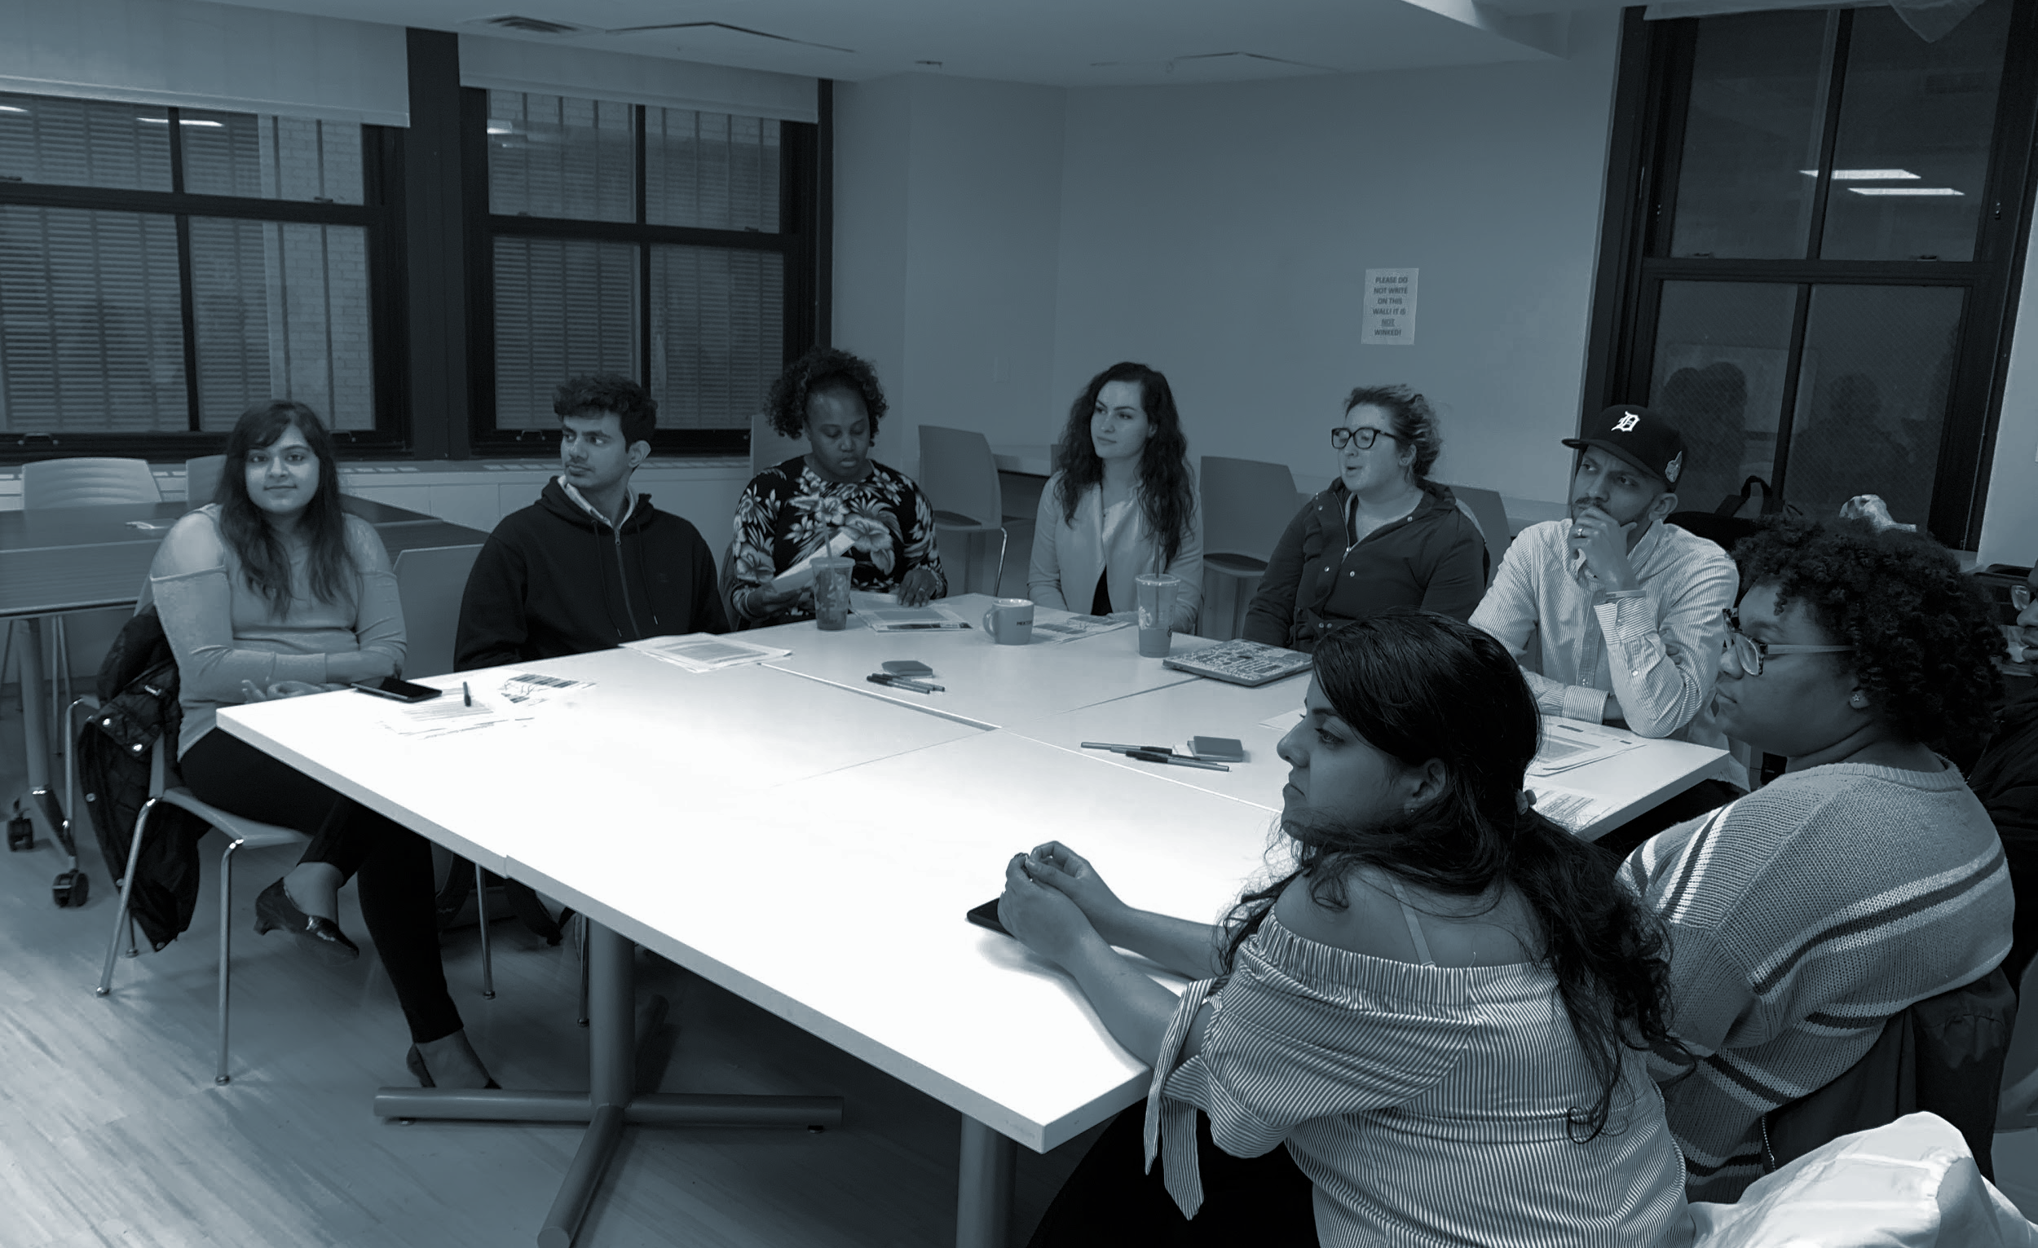
Encouraging women in maker culture
NYC Design Factory
Empathize and Redefine

Slide 2
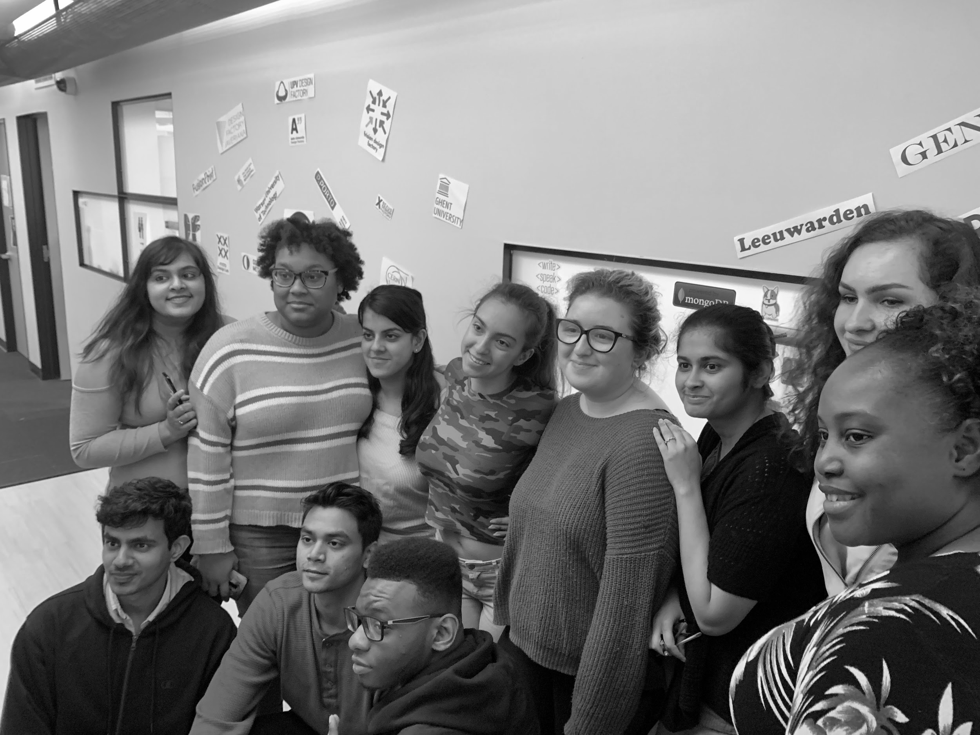
The Team
Notes:
For research purposes, please share age, gender and origin of all participants.

Slide 3
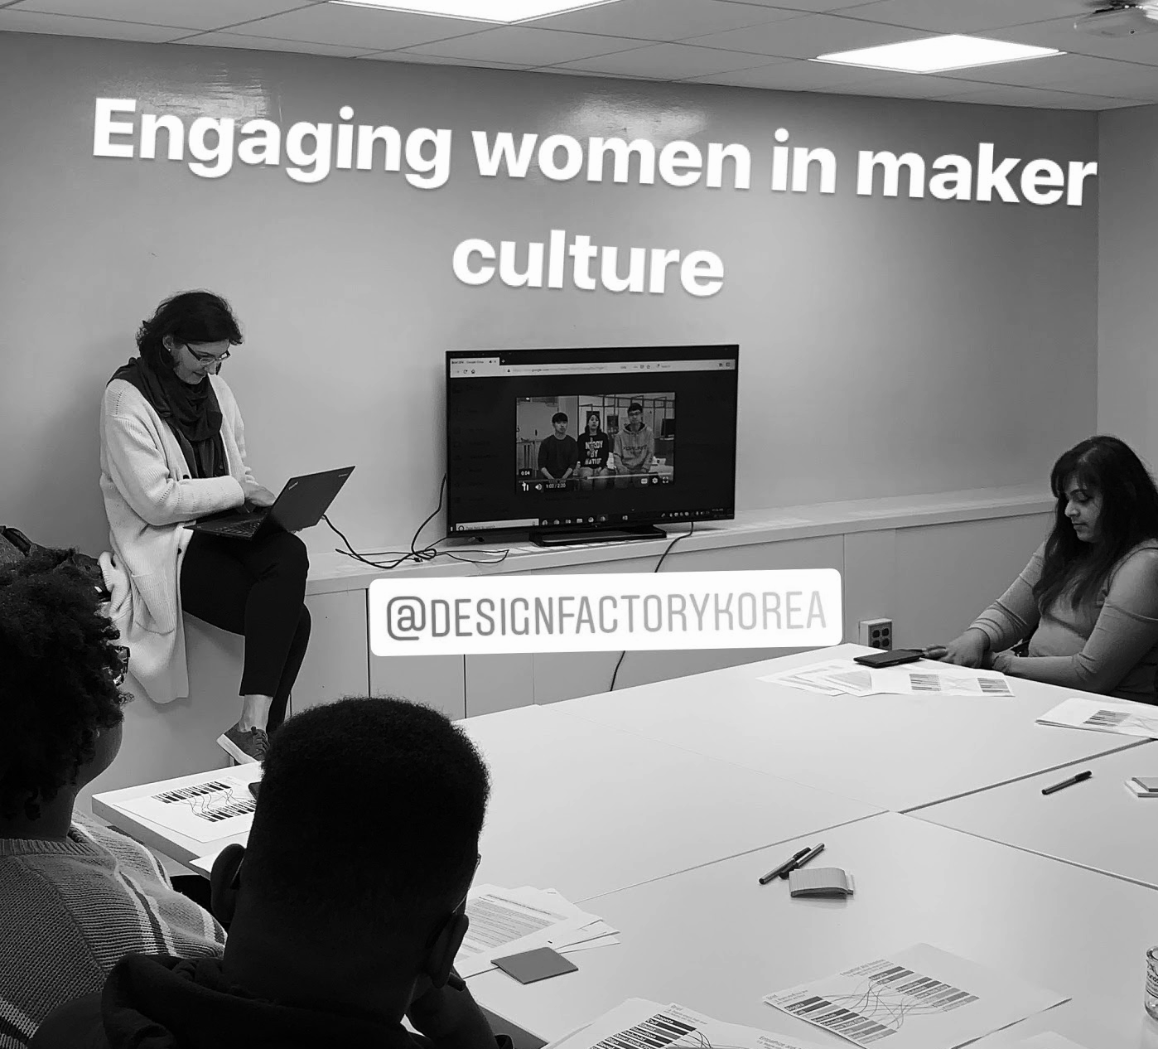
Brief
How might we encourage women so that the women could take the sustainable (and leading) roles in maker culture.

Slide 4
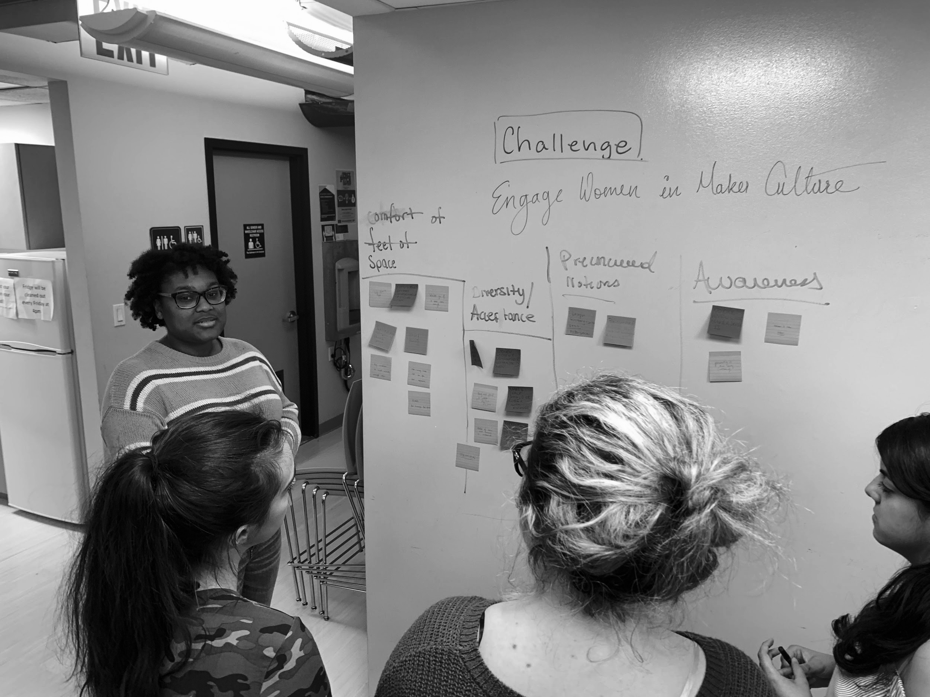
Process
Research: Secondary research from the brief and online.
Interview: Students around the campus of Pace University, NYC
Discuss: Insights and responses.
Map: Affinity mapping and grouping similar trends together

Slide 5
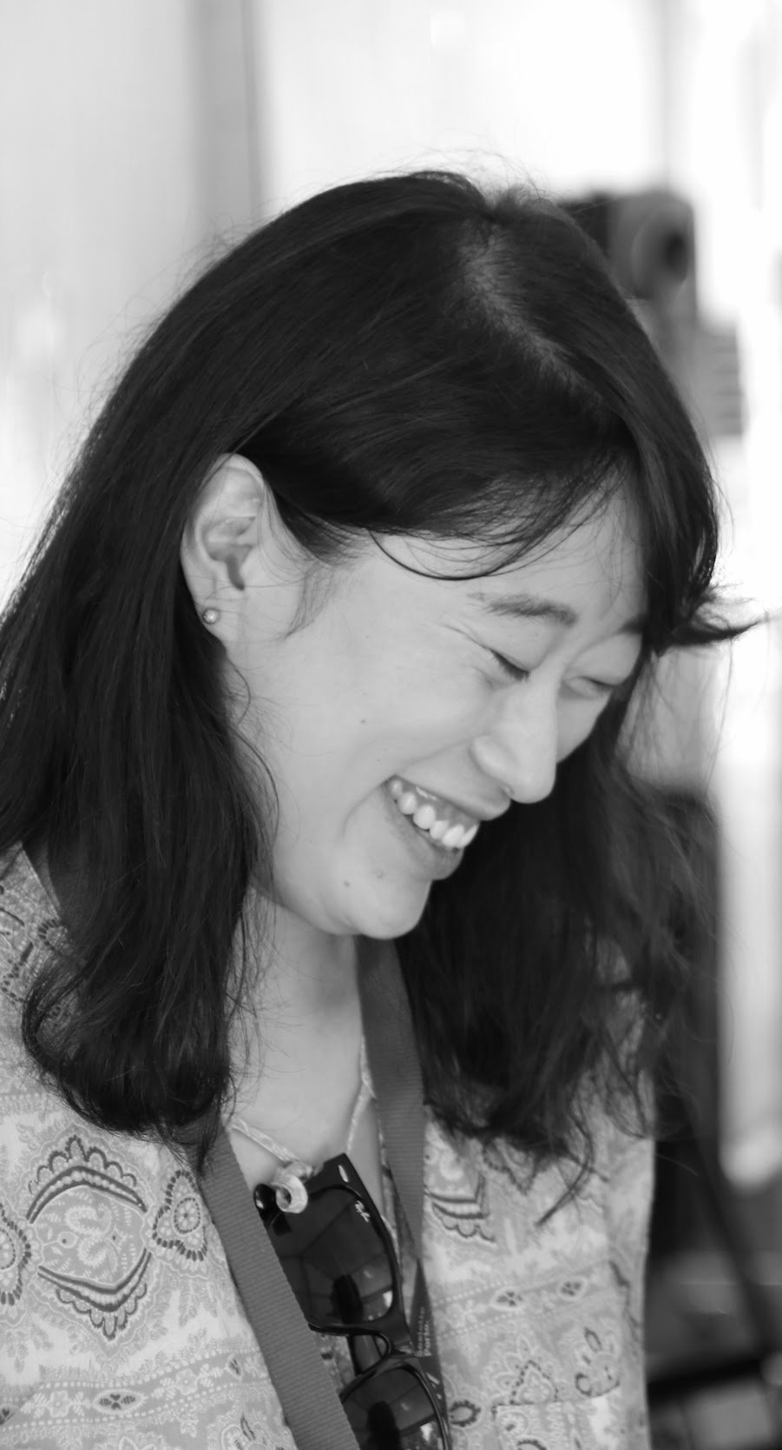
Cultural Insights
Here in Pace University we have a lot of female in STEM field and coming to activities and labs. We have a Women in Tech or Women in STEM group that meets regularly and host events and panel.
Most people did not know what maker spaces are.
People expect maker culture to be welcoming and fun.
Tools and materials that are not gender specific are expected.
Most people will go to follow their passion.
Prefer going in groups.

Slide 6
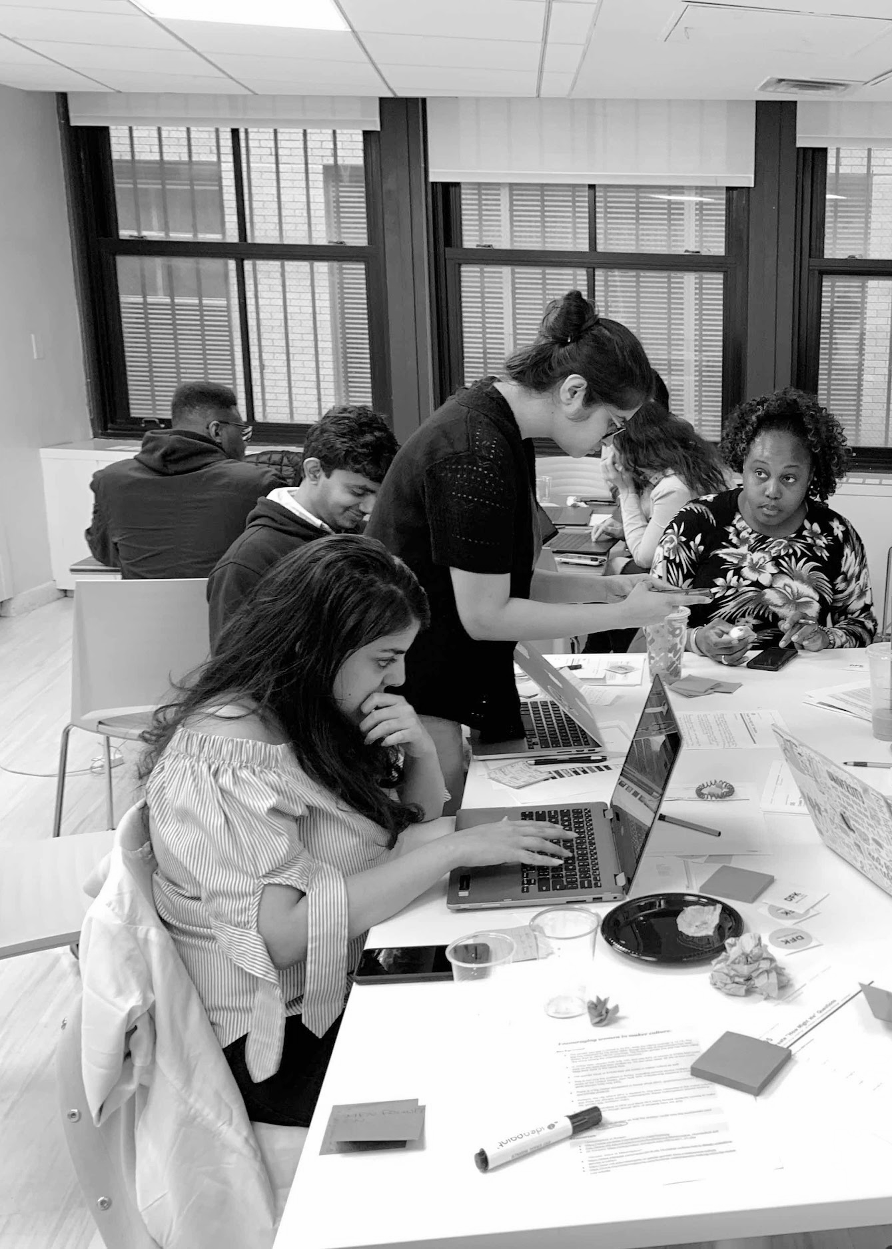
Your Task
After conducting interviews, we grouped our insights into 3 categories: Awareness, Ambiance/Comfort, Diversity Acceptance.
How might we share information about makerspaces and culture to a diverse audience especially women in a welcoming way?
How might we create a space that is welcoming to all genders and cultures?
How might we get more female leadership role models for makerspaces & maker culture?
How might we promote more diversified concept of makerspaces and the ideas that can be realized outside tech?

Slide 7
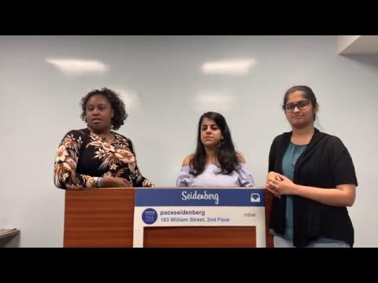
Video Handover

Slide 8
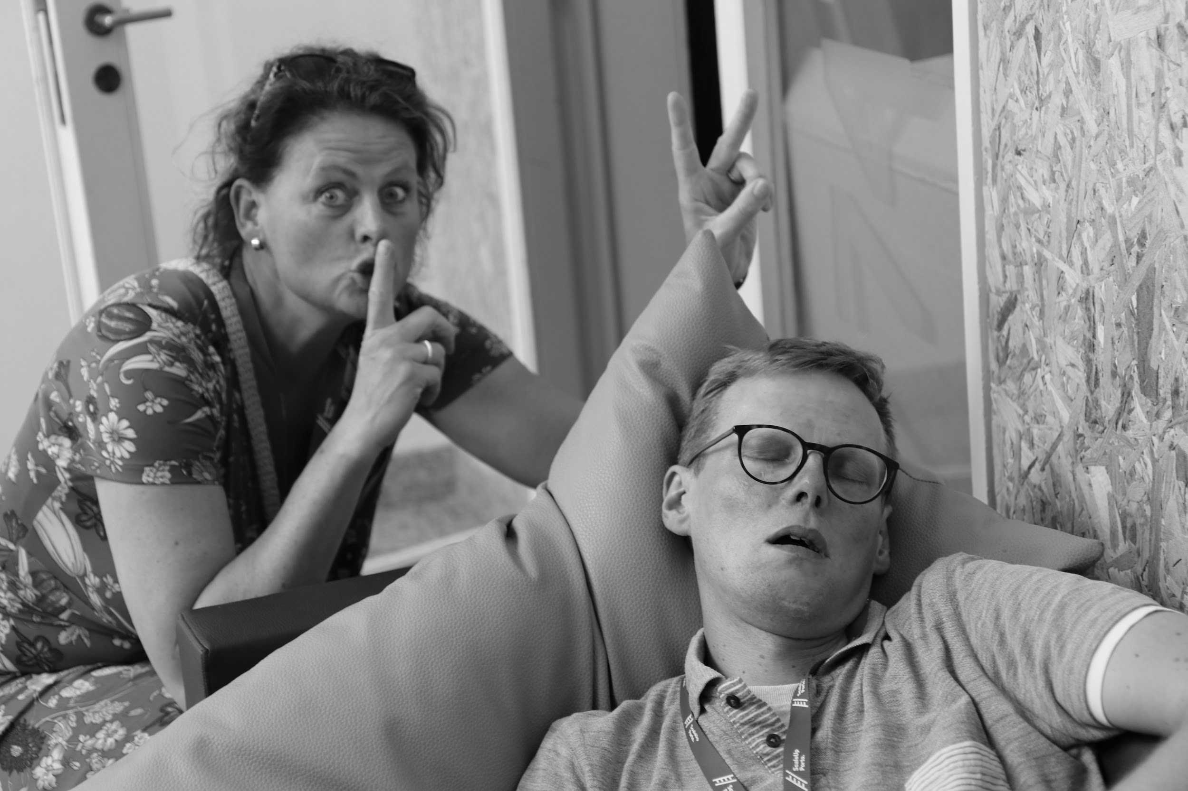
GOOD LUCK

